Slide 1

Employee Data Analysis Using Excel
Presented By - SAI MEERA.K Register No. -A1311B75CBD8B3A995E40A1E69A71E5F Department - Department of commerce Honours College - Sri Kanyaka Parameswari Arts & Science College For Women

Slide 2
Project Title
Employee Performance Analysis Using Excel

Slide 3
AGENDA
1.Problem Statement
2.Project Overview
3.End Users
4.Our Solution and Proposition
5.Dataset Description
6.Modelling Approach
7.Results and Discussion
8.Conclusion

Slide 4
Problem Statement
Overview
Organizations need to ensure that their employees' skills and competencies are constantly evolving to meet the demands of the modern workplace. The challenge is to dynamically assess and enhance employability factors to ensure a future-ready workforce.
Objective
To create an Excel-based dynamic assessment tool that evaluates and enhances employee employability by continuously tracking and analyzing various employability metrics.

Slide 5
Project Overview
Purpose
This project seeks to build a real-time monitoring system using Excel that will dynamically evaluate employability factors such as adaptability, upskilling, and learning agility, alongside traditional metrics like performance and experience.
Scope
The tool will focus on continuously updating data, reflecting changes in employee skills, industry requirements, and company needs, thus providing a dynamic view of employability.

Slide 6
End Users
Continuous Improvement Teams
To monitor and act on employability metrics.
Talent Acquisition and Management
To ensure alignment between recruitment strategies and internal skill development.
Employees
To self-assess their employability and identify areas for personal development.
Executive Leadership
To make informed decisions on workforce development and strategic planning.

Slide 7
Solution and Value Proposition
Solution
Develop an Excel-based dynamic dashboard that aggregates employability data and automatically updates it to reflect new training, performance outcomes, and evolving job market trends. This tool will highlight areas for immediate improvement and long-term development.
Value Proposition
The solution provides a proactive approach to workforce development, ensuring employees are equipped with the latest skills and competencies. This leads to increased employability, better job performance, and improved organizational agility.

Slide 8
Dataset Description
Real-Time Skills Inventory: An up-to-date list of employee skills, certifications, and proficiency levels.
Performance Reviews: Continuous performance ratings and feedback.
Training Logs: Records of all training programs, both completed and in-progress, with performance indicators.
Market Skill Requirements: Industry reports and job postings data to capture current and emerging skill demands.
Employee Feedback: Regular surveys and feedback forms on learning and development needs.
Data Structure: Dynamic Excel sheets that can be updated periodically or in real-time through data imports or manual inputs.

Slide 9
Modelling Approach
Data Integration: Combine various data sources into an Excel model that automatically updates employability metrics.
Dynamic Scoring System: Develop a scoring system that adjusts based on real-time data input (e.g., new certifications increase employability scores).
Trend Analysis: Use Excel’s data visualization tools (e.g., Sparklines, Dynamic Graphs) to track changes in employability over time, identifying upward or downward trends.
Gap Analysis: Implement a gap analysis module that highlights current skill deficiencies relative to industry standards and job role requirements.
Predictive Analytics: Use Excel’s Data Analysis Toolpak to forecast future employability trends and identify high-potential employees for leadership roles.

Slide 10
Results and Discussion
Key Metrics:
Present key employability metrics such as adaptability, learning agility, skill relevance, and performance improvement over time.
Dynamic Insights:
Discuss how the dynamic nature of the tool allows for continuous improvement, providing a real-time snapshot of employability.
Skill Development Impact:
Explore the impact of targeted training and development programs on employability scores, with case studies of employees who have significantly improved.

Slide 11
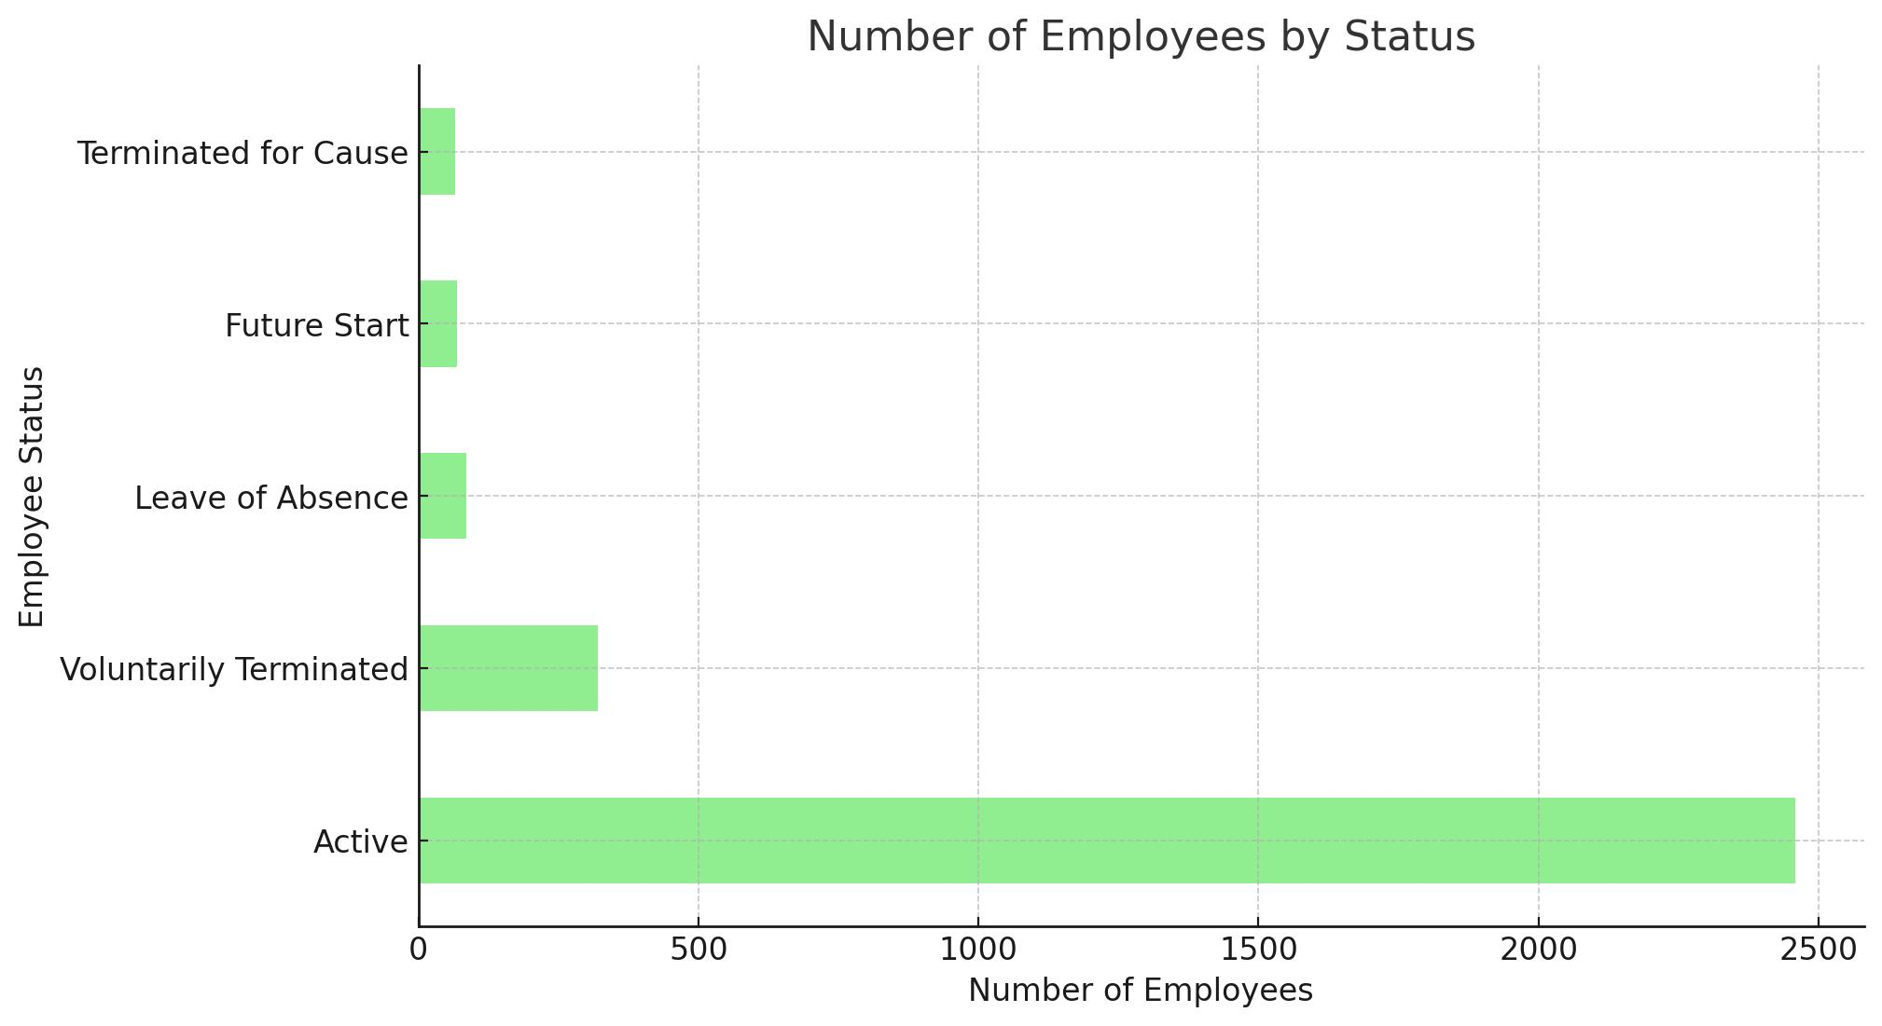

Slide 12
Conclusion
Summary of Findings:
Summarize how the dynamic analysis has provided actionable insights into employee development and employability enhancement.
Strategic Recommendations:
Offer recommendations for continuous skill development, focusing on agility, upskilling, and alignment with market demands.
Future Outlook:
Propose expanding the tool to include predictive modeling and integration with other HR systems for a comprehensive talent management solution.

